Slide 1
Permissions, Storage and Sensors
Jianjun.Chen@xjtlu.edu.cn

Slide 2
Content
Permissions
Accessing storages
Files
Database
Sensors
Location service

Slide 3

Permissions
Permission types, declaration
Notes:
https://developer.android.com/training/permissions/requesting

Slide 4
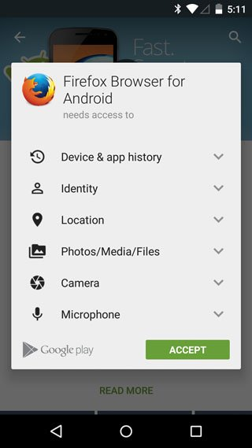
Permissions
App permissions help support user privacy by protecting access to the following:
Restricted data, such as system state and users' contact information
Restricted actions, such as connecting to a paired device and recording audio
By default, an android app has no associated permissions.
Must request permission to access sensitive user data (such as contacts and SMS)
And certain system features (such as camera and Internet)

Slide 5
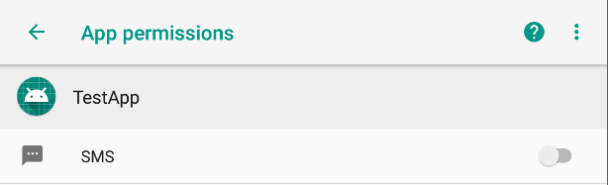
Declaring Permissions
Permissions are declared inside AndroidManifest XML using <uses-permissions> blocks.
Each block declares one permission.
One can declare several permissions.
E.g., Monitoring incoming SMS messages + sending SMS.
<manifest xmlns:android="http://schemas.android.com/apk/res/android" package="cn.edu.xjtlu.testapp"> <uses-permission android:name="android.permission.RECEIVE_SMS" /> <uses-permission android:name="android.permission.SEND_SMS" />

Slide 6
Declaring Permissions
There are many permissions defined in Android.
android.permission.ACCESS_COARSE_LOCATION
android.permission.ACCESS_NETWORK_STATE
…
A full list is available at:
https://developer.android.google.cn/reference/android/Manifest.permission
A related link:
https://developer.android.google.cn/guide/topics/manifest/uses-permission-element

Slide 7
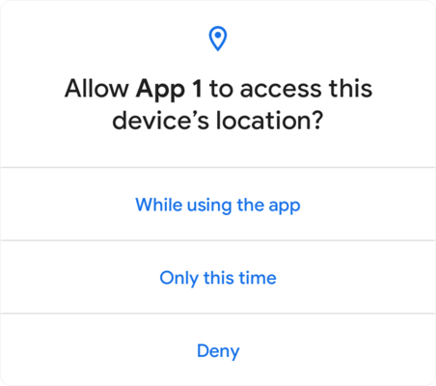
Permission Initial State
Install-time permissions: Automatically granted when the app is installed.
Developer still needs to declare permissions in the manifest file first.
Don't pose much risk to the user's privacy or the device's operation
E.g., Request for setting time zone.
Runtime permissions:
Potentially affect the user's privacy or the device's normal operation.
Such as the SEND_SMS permission.
Android 5.1 or lower: User can grant these permissions when apps are installed. But pre-installed apps can have these permissions pre-granted.
Android 6.0+: User must explicitly agree to grant those permissions at runtime.
Android 11: One-time permission is added.

Slide 8

Data Management
Internal/External Files, SharedPreferences, SQLite Database

Slide 9
Data Management Overview
App-specific storage:
Used by your app only.
Further divided into internal storage and external storage.
Shared storage:
The files stored can be read/written by other apps.
Preferences:
Key-value pairs of primitive data that can only read by your app.
Databases:
App’s private database storage.

Slide 10
App-Specific Storage
“I brought a phone
with 64GB storage”
 |  | Internal Storage | External Storage
Availability |  | Built-in memory (always accessible) | Built-in memory or SD card (not always accessible)
Permissions |  | Not needed | Not needed in Android 4.4 or higher (API level 19+)
Accessibility |  | Files are accessible only by your app by default | Files are world-readable and can be modified when USB is connected
Persistence |  | Files are removed when the app is uninstalled | May not be completely removed
Encryption |  | Encrypted since Android 10.

Slide 11
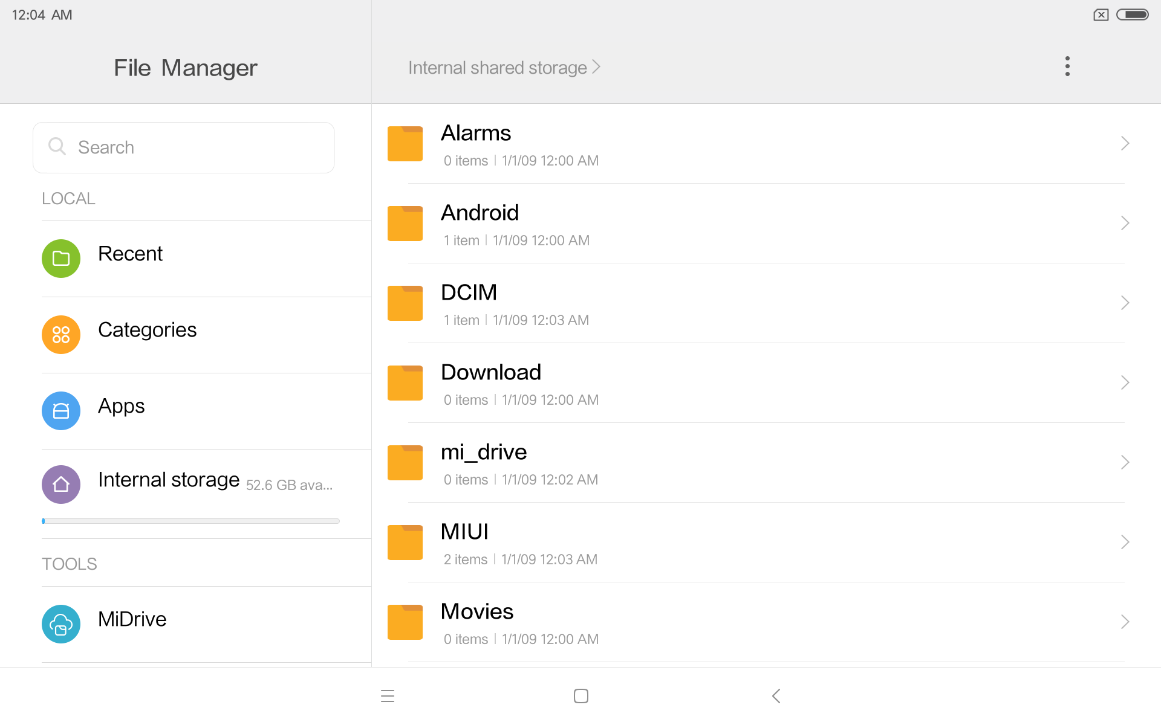
Internal and External Storage
E.g., Our Xiaomi tablet has a built-in storage mounted at folder “/storage/emulated/0” (or sdcard0)
Part of it is used as internal memory
Part of it is used as external memory
Inserted SD card is called “secondary external storage”.
Files you see here are from the external memory

Slide 12
Internal App-Specific Storage
You can use Java build-in class File to manage files in the internal storage:
Alternatively, you can use openFileOutput() and openFileInput() to write and read files.
File file = new File(context.getFilesDir(), "filename");
try (FileOutputStream fos =
openFileOutput("myfile", Context.MODE_PRIVATE)) { fos.write("Hello world!".getBytes()); } catch (Exception e) { ... }
try (FileInputStream fis = openFileInput("myfile")) { BufferedReader br = new BufferedReader(new InputStreamReader(fis)); String line = br.readLine();
... } catch (Exception e) { ... }

Slide 13
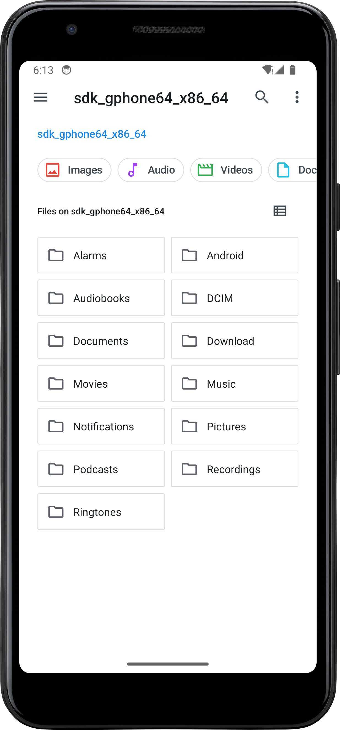
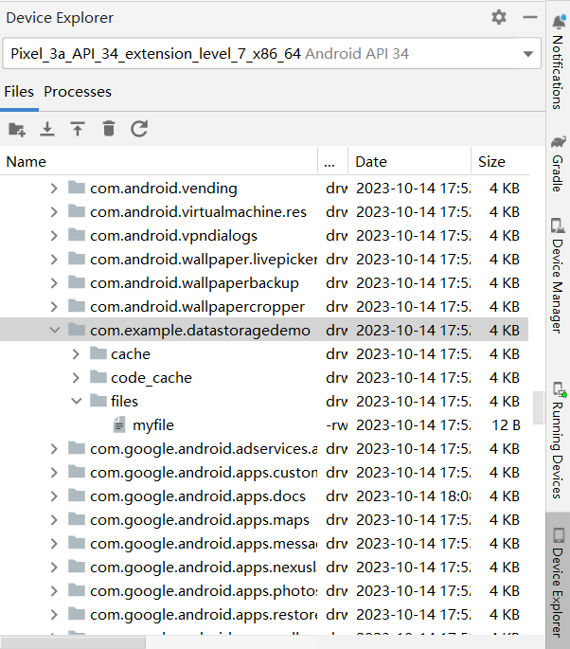
About Internal Storage
The internal storage is not visible from your File app.
If you use the “Device Explorer” of Android Studio, you can find the internal storage under “/data/data/app-package-name”

Slide 14
External Memory Files
Removable media may disappear without warning.
Need to get the status of external storage: Environment.getExternalStorageState()
Get external directory: getExternalFilesDir()
MEDIA_MOUNTED | present & mounted with read/ write access
MEDIA_MOUNTED_READ_ONLY | present & mounted with read -only access
MEDIA_REMOVED | not present
if (Environment.getExternalStorageState()
.equals(Environment.MEDIA_MOUNTED)) { File f = new File(getExternalFilesDir(null), "myExtFile"); try (FileOutputStream fos = new FileOutputStream(f, false)) { fos.write("Hello External World".getBytes()); } catch (Exception e) { e.printStackTrace(); } }
Append?

Slide 15
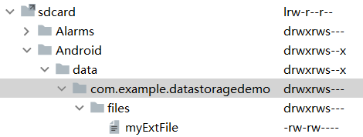
External Memory Files
External memory files can be found in:
/sdcard/Android/data/app-package-name/files
The same folder returned by getExternalFilesDir()
External files are usually removed automatically by Android when the app is uninstalled.

Slide 16
App-Specific Storage: Extended Reading
The previous slides are about managing persistent files.
Read about how to create/clear cache files in the storage of your app:
https://developer.android.com/training/data-storage/app-specific

Slide 17
SharedPreference
Shared Preferences store private primitive data in key-value pairs in internal memory.
primitive data: booleans, floats, ints, longs, and Strings.
The data will persist across user sessions (even if your application is killed).
Good for storing small pieces of data like user ID.
Example:
SharedPreferences usp =
getSharedPreferences("User info", Context.MODE_PRIVATE); int userID = usp.getInt("user-id", 0); String username = usp.getString("username", "empty");
SharedPreferences nsp =
getSharedPreferences("Network info", Context.MODE_PRIVATE); String ipAddr = nsp.getString("ip-addr", "127.0.0.1");
The default value if it is not set previously

Slide 18
SharedPreference
Context.getSharedPreferences(String name, int mode)
Retrieve a SharedPreferences object, using the “name”.
Only one instance is returned to any callers, meaning they will see each other's edits as soon as they are made.
Activity.getPreferences(int mode)
Retrieve a SharedPreferences object for accessing preferences that are private to this activity.
The mode parameter could be:
MODE_PRIVATE,
MODE_WORLD_READABLE (deprecated!)
MODE_WORLD_WRITEABLE (deprecated!)

Slide 19
Writing SharedPreferences
Writing preferences:
Call the SharedPreferences.edit() method and get an instance of editor.
Write data using functions like putInt() …
Commit the change by calling the method SharedPreferences.Editor.commit().
Example
SharedPreferences usp =
getSharedPreferences("User info", Context.MODE_PRIVATE); int userID = usp.getInt("user-id", 0); String username = usp.getString("username", "empty");
SharedPreferences.Editor uspEditor = usp.edit(); uspEditor.putInt("user-id", 654321); uspEditor.commit();

Slide 20
SQLite
SQLite provides in-memory database
Designed to operate within a very small footprint (<300kB) within a single cross-platform disk file
Implements most of SQL92 and Supports ACID transactions
atomic, consistent, isolated & durable.
In Android, one can use SQLiteOpenHelper
Example: We want to build a table "Contacts" to record contact information.

Slide 21
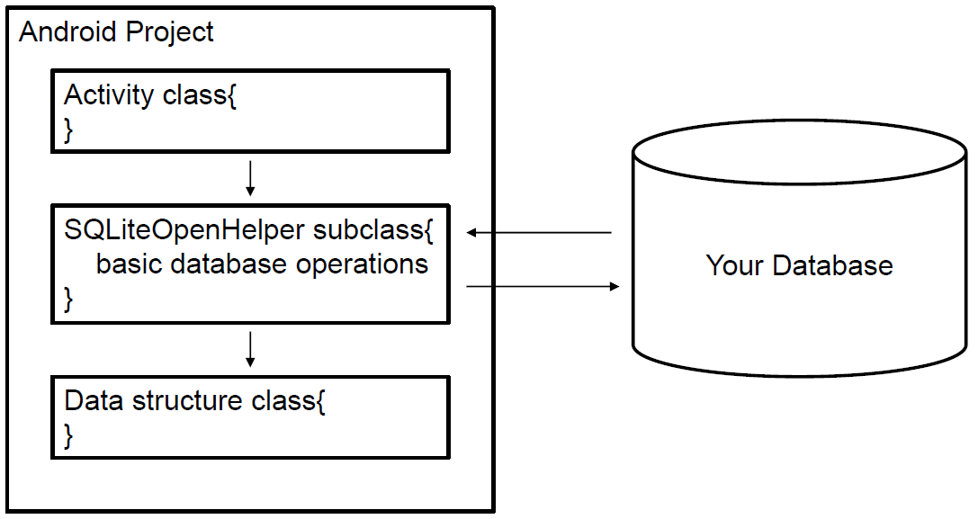
SQLite Example: Solution
Overall Framework

Slide 22
public class Contact { int _id; String _name; String _phone_number; public Contact(int id, String name, String _phone_number){ this._id = id; this._name = name; this._phone_number = _phone_number;} public int getID() { return this._id;} public void setID(int id) { this._id = id;} public String getName() { return this._name;} public void setName(String name) { this._name = name;} public String getPhoneNumber() { return this._phone_number;} public void setPhoneNumber(String phone_number)
{ this._phone_number = phone_number;} }

Slide 23
public class MyContactDatabase
extends SQLiteOpenHelper { final int DATABASE_VERSION = 1; final String DATABASE_NAME = "contactsManager"; final String TABLE_CONTACTS = "contacts"; final String KEY_ID = "id"; // Contacts Table Columns names final String KEY_NAME = "name"; final String KEY_PH_NO = "phone_number"; public MyContactDatabase(Context context) { super(context, DATABASE_NAME, null, DATABASE_VERSION); } @Override public void onCreate(SQLiteDatabase db) { String CREATE_CONTACTS_TABLE = "CREATE TABLE " + TABLE_CONTACTS + "(" + KEY_ID + " INTEGER PRIMARY KEY," + KEY_NAME + " TEXT," + KEY_PH_NO + " TEXT" + ")"; db.execSQL(CREATE_CONTACTS_TABLE); } @Override public void onUpgrade(SQLiteDatabase sqLiteDatabase, int i, int i1) {}
Increasing the version here, onUpgrade() will be called
only run when the database file did not exist and was just created
only called when the database file exists but the stored version number is lower than requested in constructor.

Slide 24
public void addContact(Contact contact) { SQLiteDatabase db = this.getWritableDatabase(); // ContentValues() class is used to store a set of // values that content resolver can handle ContentValues values = new ContentValues(); values.put(KEY_NAME, contact.getName()); // Contact Name values.put(KEY_PH_NO, contact.getPhoneNumber()); // Contact Phone Number // Inserting Row db.insert(TABLE_CONTACTS, null, values); db.close(); // Closing database connection } public Contact getContact(int id) { SQLiteDatabase db = this.getReadableDatabase(); Cursor cursor = db.query(TABLE_CONTACTS,
new String[] { KEY_ID, KEY_NAME, KEY_PH_NO }, KEY_ID + "=?",
new String[] {String.valueOf(id) }, null, null, null, null); if (cursor != null)
cursor.moveToFirst(); Contact contact = new Contact(Integer.parseInt(cursor.getString(0)), cursor.getString(1), cursor.getString(2)); return contact; }
you can execute a sql statement here like
String ROW1 = "INSERT INTO " + …;
db.execSQL(ROW1);

Slide 25
public class MyContactActivity
extends AppCompatActivity { @Override protected void onCreate(Bundle savedInstanceState) { super.onCreate(savedInstanceState); setContentView(R.layout.activity_my_contact); MyContactDatabase db = new MyContactDatabase(this); db.addContact(new Contact(1012, "Alice", "88160000")); db.addContact(new Contact(913, "Bob", "88160001")); // Reading contact Contact contact = db.getContact(1); String log = "Id: "+ contact.getID()+" ,Name: "
+ contact.getName() + " ,Phone: “
+ contact.getPhoneNumber(); // Writing Contacts to log Log.d("Name: ", log); } }

Slide 26
Extended Readings
Shared storage has not been covered. Please read this topic in the tutorial here: https://developer.android.com/training/data-storage/shared

Slide 27
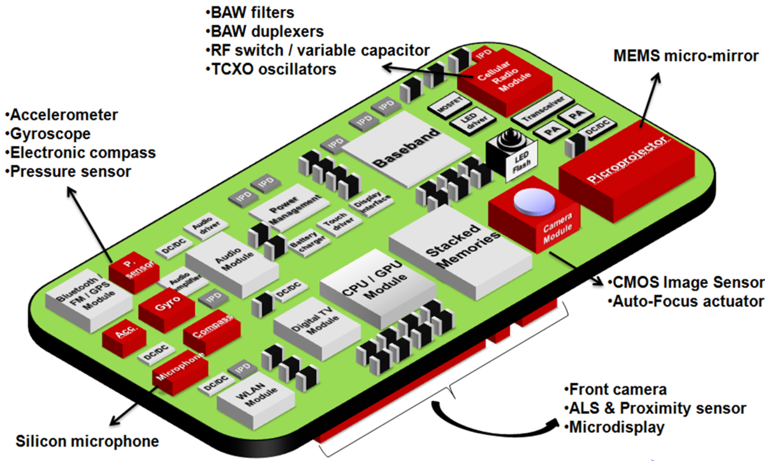
Sensors
Sensor types
Sensor manager

Slide 28
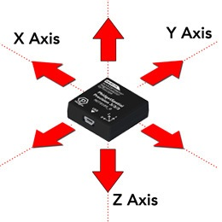
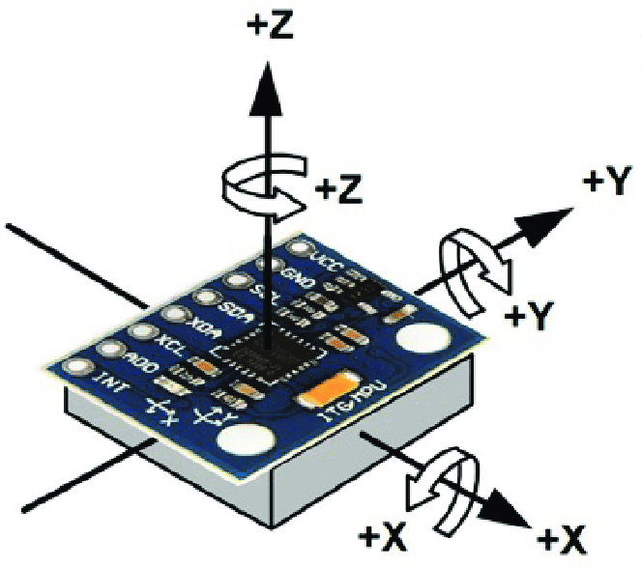
Sensors
Most Android-powered devices have built-in sensors that measure the physical environment
Commonly used smart phone sensors
Motion sensors
3-axis Accelerometer
3-axis Magnetometer
Gyroscope
Environmental sensors
Light sensor
Noise
https://www.livescience.com/40103-accelerometer-vs-gyroscope.html
Notes:
A magnetometer is a device that measures magnetism—the direction, strength, or relative change of a magnetic field at a particular location. The measurement of the magnetization of a magnetic material (like a ferromagnet) is an example. A compass is one such device, one that measures the direction of an ambient magnetic field, in this case, the Earth's magnetic field.
A gyroscope (from Ancient Greek γῦρος gûros, "circle" and σκοπέω skopéō, "to look") is a device used for measuring or maintaining orientation and angular velocity.^{[1][2]} It is a spinning wheel or disc in which the axis of rotation (spin axis) is free to assume any orientation by itself. When rotating, the orientation of this axis is unaffected by tilting or rotation of the mounting, according to the conservation of angular momentum.

Slide 29
Access Sensors
You can access sensors available on the device and acquire raw sensor data by using the Android sensor framework. Steps involved:
Determine which sensors are available on a device.
Determine an individual sensor's capabilities, such as its maximum range, manufacturer, power requirements, and resolution.
Register and unregister sensor event listeners that monitor sensor changes.
Acquire raw sensor data and define the minimum rate at which you acquire sensor data.

Slide 30
Step 1: Get List of Sensors
First identify the sensors that are on the device
obtain an instance of the SensorManager class by calling the getSystemService() method.
passing in the SENSOR_SERVICE argument.
We can (optionally) get a listing of every sensor:
private SensorManager sensorManager;
...
sensorManager = (SensorManager) getSystemService(Context.SENSOR_SERVICE);
List<Sensor> allSensors = sensorManager.getSensorList(Sensor.TYPE_ALL);

Slide 31
Step 2: Check Sensor Capabilities
Test if certain type of sensor exists.
Sensor types constants:
if (sensorManager.getDefaultSensor(Sensor.TYPE_MAGNETIC_FIELD) != null){ // Success! There's a magnetometer } else { // Failure! No magnetometer. }
let you determine how close the face of a device is to an object*
TYPE_ACCELEROMETER
TYPE_GRAVITY
TYPE_GYROSCOPE
TYPE_LIGHT
TYPE_MAGNETIC_FIELD
TYPE_PRESSURE
TYPE_PROXIMITY
TYPE_TEMPERATURE
Air pressure
*during a telephone call, proximity sensors play a role in detecting (and skipping) accidental touchscreen taps when mobiles are held to the ear.

Slide 32
Step 3-4: Register Listener
To monitor sensor data, you need to implement two callback methods in SensorEventListener:
A sensor's accuracy changes: onAccuracyChanged(Sensor s, int accuracy)
A sensor reports a new value: onSensorChanged(SensorEvent e)
Then, register the listener with sampling rate.
sensor = sensorManager.getDefaultSensor(Sensor.TYPE_LIGHT); sensorManager.registerListener(listener, sensor,
SensorManager.SENSOR_DELAY_NORMAL);
The rate sensor events are delivered at
Notes:
Third parameter of registerListener
The rate sensor events are delivered at. This is only a hint to the system. Events may be received faster or slower than the specified rate. Usually events are received faster. The value must be one of SENSOR_DELAY_NORMAL, SENSOR_DELAY_UI, SENSOR_DELAY_GAME, or SENSOR_DELAY_FASTEST or, the desired delay between events in microseconds. Specifying the delay in microseconds only works from Android 2.3 (API level 9) onwards. For earlier releases, you must use one of the SENSOR_DELAY_* constants

Slide 33
The Sensor Object
The sensor object allows you to get a lot of information about the related sensor.
getResolution()
getMaximumRange()
getMinDelay(): returns the minimum time interval (in microseconds) that a sensor can use to sense data.
For a streaming sensor (reports data repeatedly at a frequency), it will return a valid value.
For a non-streaming sensor (only report data when sensor feels the change), it will return 0.

Slide 34
Sensors Access: Summary
Four types of interfaces
SensorManager: You can use this class to create an instance of the sensor service.
Sensor: You can use this class to create an instance of a specific sensor.
SensorEvent: used to create a sensor event object, which provides information about a sensor event.
SensorEventListener: used to create two callback methods that receive notifications (sensor events)
Two basic tasks based on the above interfaces
Identifying sensors and sensor capabilities
Monitor sensor events

Slide 35
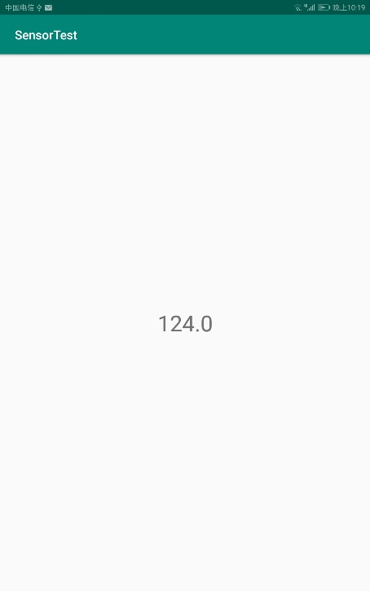
Sensor Example
We will implement an app that tracks the current light level received from the ambient light sensor.

Slide 36
Full example: Listener
public class LightSensorTest extends AppCompatActivity { SensorEventListener listener = new SensorEventListener() { @Override public void onSensorChanged(SensorEvent sensorEvent) { float lux = sensorEvent.values[0]; TextView tv= (TextView) findViewById(R.id.luxIndicator); tv.setText(String.valueOf(lux)); } @Override public void onAccuracyChanged(Sensor sensor, int accuracy) { // Do something here if sensor accuracy changes. } }; ......

Slide 37
Full example: Activity
private SensorManager sensorManager; private Sensor sensor; @Override protected void onCreate(Bundle savedInstanceState) { super.onCreate(savedInstanceState); setContentView(R.layout.activity_light_sensor_test);
sensorManager =
(SensorManager) getSystemService(Context.SENSOR_SERVICE); sensor = sensorManager.getDefaultSensor(Sensor.TYPE_LIGHT); sensorManager.registerListener(listener, sensor,
SensorManager.SENSOR_DELAY_NORMAL); } @Override protected void onPause() { super.onPause(); sensorManager.unregisterListener(listener); }

Slide 38

Location Service
How to obtain current location
Accuracy issues

Slide 39

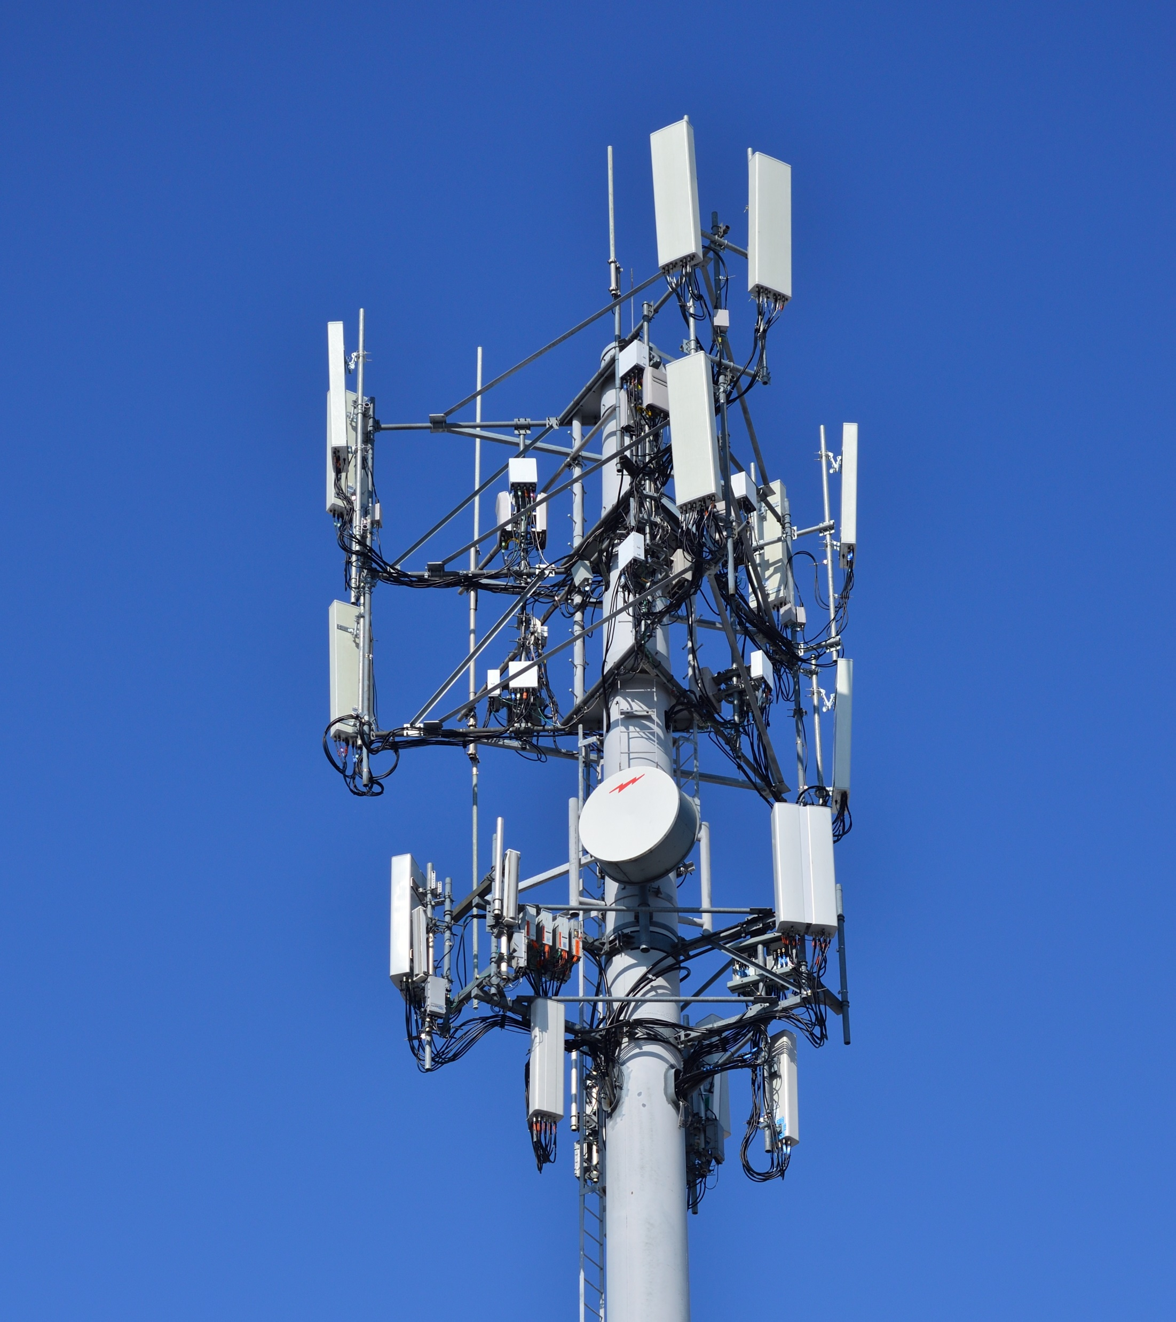
Location Service
Location service allows an app to obtain global navigation information from the phone.
In recent phones, most kinds of navigation satellites are supported and will be used in a mixed fashion.
GPS (US)
Galileo (EU)
Glonass (Russia)
Beidou (China)
Cell towers and Wi-Fi can also provide navigation information.
Location information affects user privacy.

Slide 40
Permissions of Location Service
Two types of location service:
Network-based: Using cell tower and WiFi signal.
Satellite-based: Using GPS.
Must declare permissions in the manifest file first.
One must also define coarse location if he needs fine location
<uses-permission android:name= "android.permission.ACCESS_COARSE_LOCATION"/>
<uses-permission android:name= "android.permission.ACCESS_FINE_LOCATION"/>
Grants permission to use network-based location service
Grants permission to use network-based and GPS-based location service

Slide 41
Using Location Service
To use location service, first get LocationManager.
Then implement a LocationListener.
Register LocationListener with the LocationManager.
Location information will be sent to listener’s call-back function.
Unregister it when location service is not needed.
LocationManager locationManager = (LocationManager)
this.getSystemService(Context.LOCATION_SERVICE);
Context::getSystemService(String name)

Slide 42
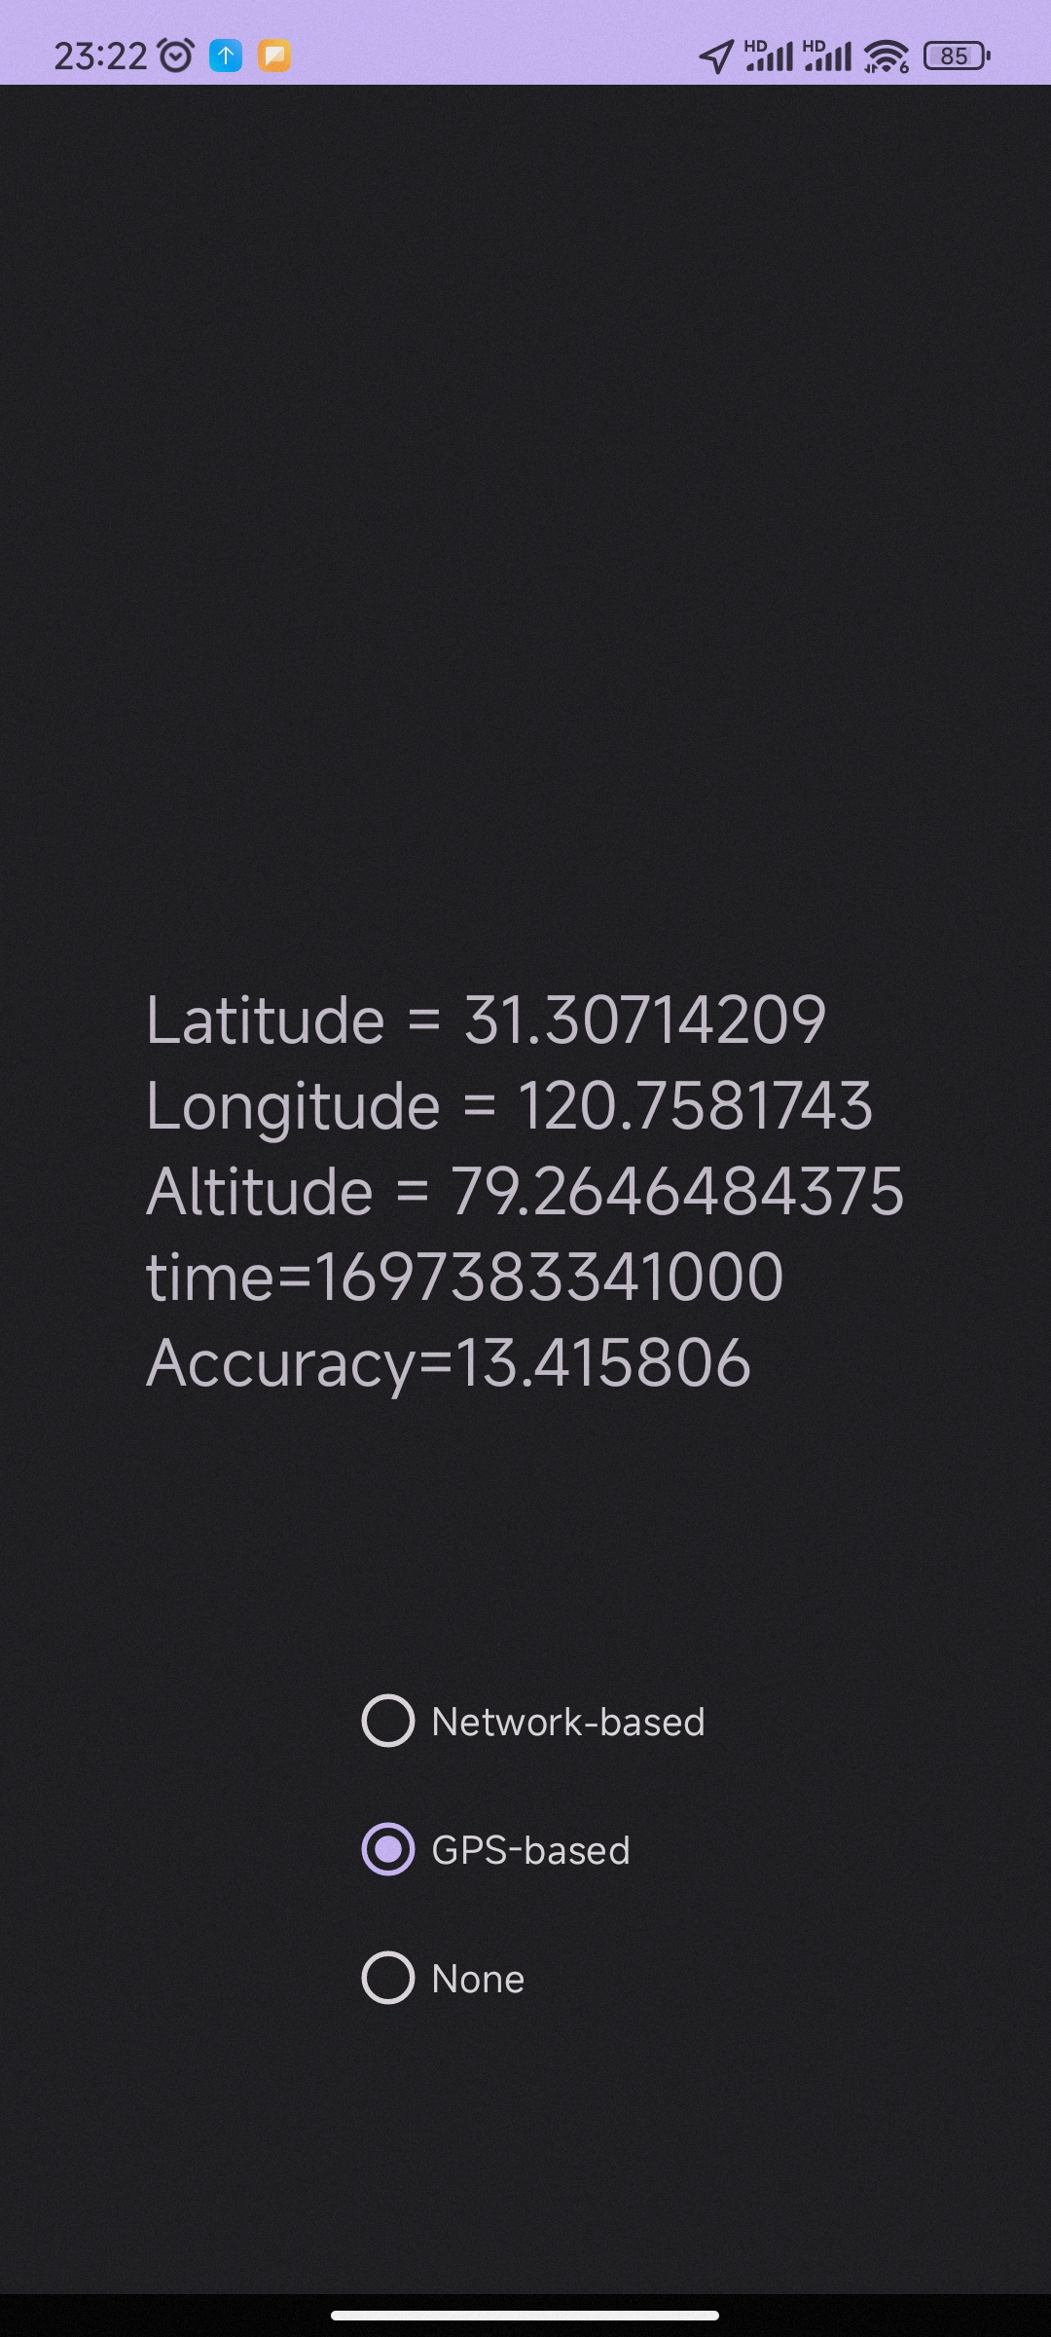
The Example
In the next example, we will build an app that allows you to:
Locate the current position using cell phone & WiFi signal.
Locate the current position using GPS-based location service.
Turn off location service.
The information will be shown in the middle of the screen.

Slide 43
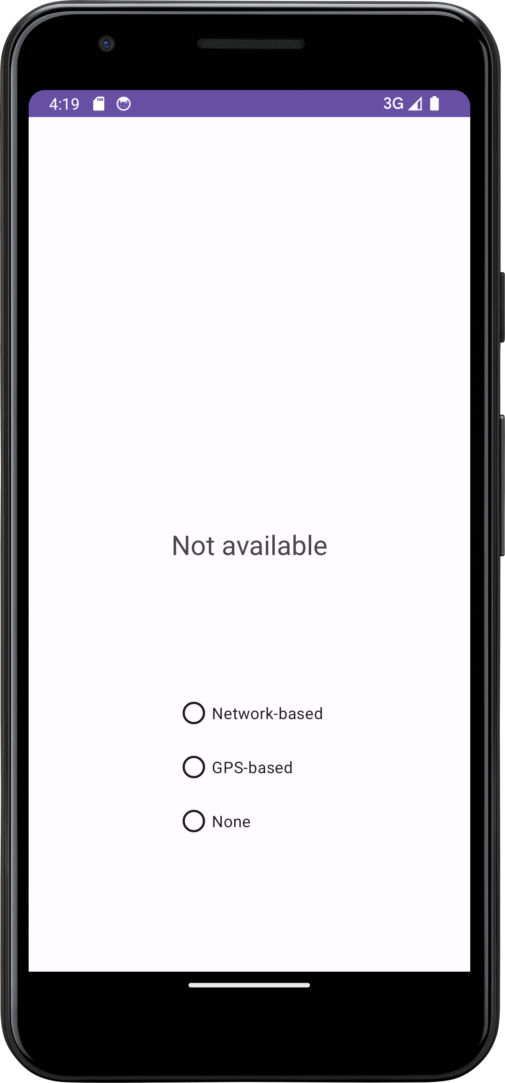
Step 1: Create the Activity
We first create the activity and its layout.
Here, radio group is used for single choice
<RadioGroup android:id="@+id/locationMethod“ > <RadioButton android:id="@+id/nwBasedBtn" android:text="Network-based" /> <RadioButton android:id="@+id/gpsBasedBtn" android:text="GPS-based" /> <RadioButton android:id="@+id/noLocation" android:text="None" /> </RadioGroup>

Slide 44
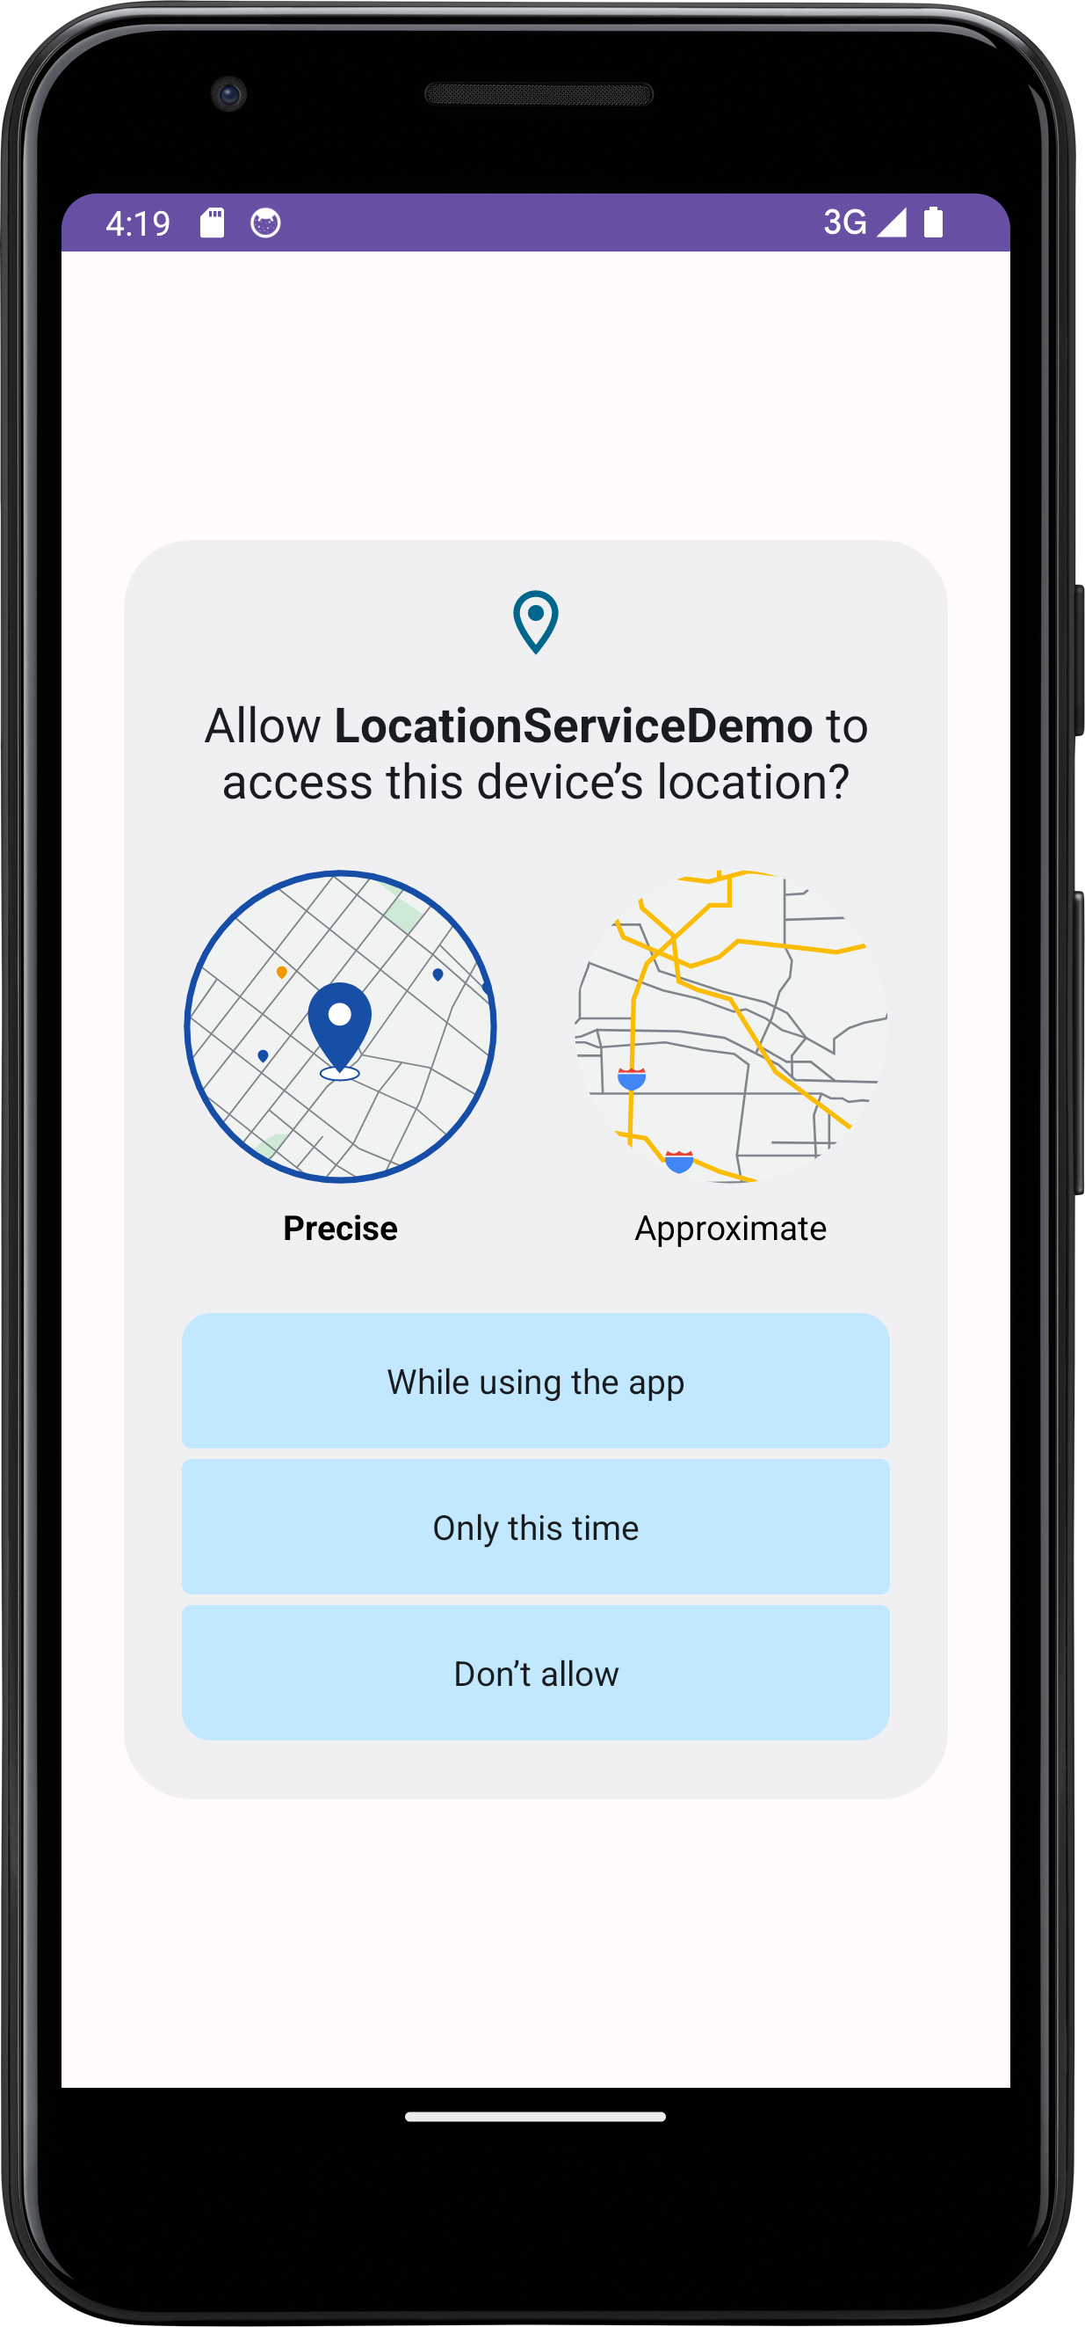
Step 2: Request for Permission
Your app should actively request for permissions.
Otherwise, the user needs to manually enable permissions in “Settings”.
Not user-friendly.
if (checkSelfPermission(Manifest.permission.ACCESS_FINE_LOCATION)
!= PackageManager.PERMISSION_GRANTED) { requestPermissions(new String[] {Manifest.permission.ACCESS_FINE_LOCATION,
Manifest.permission.ACCESS_COARSE_LOCATION}, 1); }

Slide 45
Step 3: Creating Callback Class
*This Listener is defined inside LocationActivity
LocationListener listener = new LocationListener() { public void onLocationChanged(Location location) { TextView tv = (TextView) findViewById(R.id.locationLabel); tv.setText("location=" + location.getLatitude() + "; " + "time=" + location.getTime() + "; " + "Accuracy=" + location.getAccuracy() + "\n"); } public void onStatusChanged(String provider,
int status, Bundle extras) { Log.i("LocationTester", "provider status is changed"); } public void onProviderEnabled(String provider) { Log.i("LocationTester", "provider is enabled"); } public void onProviderDisabled(String provider) { Log.i("LocationTester", "provider is closed"); } };
Deprecated
Can be found out by calling
LocationManager.getAllProviders()
Notes:
Provider is either network_provider or gps_provider

Slide 46


The Location Class
It’s a data class representing a geographic location.
getLatitude()
getLongitude()
getAltitude()
getSpeed()
getAccuracy()
Get the estimated accuracy of this location, in meters.
Check the API for details.

Slide 47
Step 3: Configure Activity
@Override protected void onCreate(Bundle savedInstanceState) { ... RadioGroup methodChoice = findViewById(R.id.locationMethod); final LocationManager locationManager = (LocationManager)
LocationActivity.this.getSystemService(Context.LOCATION_SERVICE);
methodChoice.setOnCheckedChangeListener(new
RadioGroup.OnCheckedChangeListener() { @Override public void onCheckedChanged(RadioGroup radioGroup, int i) {
} }); }
See the next slide

Slide 48
Step 4: Register Callback Class
@Override public void onCheckedChanged(RadioGroup radioGroup, int i) { if (i == radio1.getId()) { try { locationManager.requestLocationUpdates(
LocationManager.NETWORK_PROVIDER, 0, 0, listener); } catch (SecurityException e) { ... } } else if (i == radio2.getId()) { try { locationManager.requestLocationUpdates(
LocationManager.GPS_PROVIDER, 0, 0, listener); } catch (SecurityException e) { ... } } else { locationManager.removeUpdates(listener); TextView tv = (TextView) findViewById(R.id.locationLabel); tv.setText("Location Service OFF"); } }
Happens when permission not granted

Slide 49
minimum time interval between location updates, in milliseconds
minimum distance between location updates, in meters
requestLocationUpdates(LocationManager.NETWORK_PROVIDER, 0, 0, listener)
The type of location service:
LocationManager.NETWORK_PROVIDER
LocationManager.GPS_PROVIDER
a LocationListener whose onLocationChanged(Location) method will be called for each location update

Slide 50
The Implementation Flow
Get the LocationManager
Implement a LocationListener and register it with the LocationManager
LocationManager will then send location information to the LocationListener. The location information is packed inside a Location object.
Unregister the LocationListener when location service is no longer needed

Slide 51
Getting the Last Location
Apart from getting the location anew, you can obtain the last known location by calling:
This method returns a Location object, from which you can get all needed information.
You can use this to quickly get a (possibly inaccruate) position.
Location lastLocation = locationManager.getLastKnownLocation(LocationManager.NETWORK_PROVIDER);

Slide 52
Obtain the Best Performance
Flow for obtaining user location
Start application, get previous location stored locally
Start listening for updates from the location providers.
Maintain a "current best estimate" of location by filtering out new, but less accurate fixes.
Stop listening for location updates.
Take advantage of the last best location estimate.

Slide 53
Obtain the Best Performance
Is the most recent location the most accurate?
Not necessarily
You can validate the accuracy of a location via:
Check if the location retrieved is significantly newer than the previous estimate.
Check if the accuracy claimed by the location is better or worse than the previous estimate.
Check which provider the new location is from and determine if you trust it more.

Slide 54
Location Services: Considerations
Location results may not be accurate
Multitude of location sources such as GPS, Cell-ID, and Wi-Fi have different errors
User movement could affect location accuracy.
Power consumption-location measurement really drains the battery. To limit battery use:
Return updates less frequently
Restrict the set of Location Providers
Always check last known measurement
Turn off updates in Activity::onPause().

Slide 55
Extended Reading
In this lecture, both sensors and location services uses the getSystemService() function.
There are many more types of system services.
You should check for those if your app is involved with any one of these system services.
Have a look at the API document for Context.getSystemService()

Slide 56
Lab Task
Extend the MusicPlayerDemo
So that it records how many songs it played using shared preference.
So that the music play history is stored in the internal/external storage.

